Slide 1
Introduction to Neural Networks (2):
Feedforward and Backpropagation
Instructor: Mohammad Hasan
Office: 13-240
10/02/26
Notes:
Welcome and Introductions

Slide 2
Overview
How Neural Networks Work
Gradient Descent for Learning
Backpropagation
Vanish Gradient and Dead ReLU Problems

Slide 3
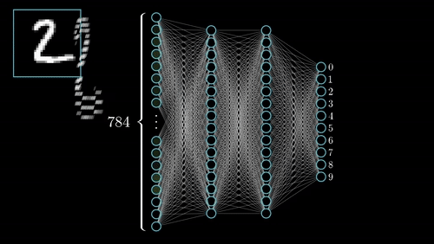
Information Processing in NN
Generally, information flows within a neural network in one direction during prediction. From back to front (input ‘terminal’ to output ‘terminal’).
Numerical data go through a sequence of non-linear transformations (through activation functions) and end at the output layer.

Slide 4
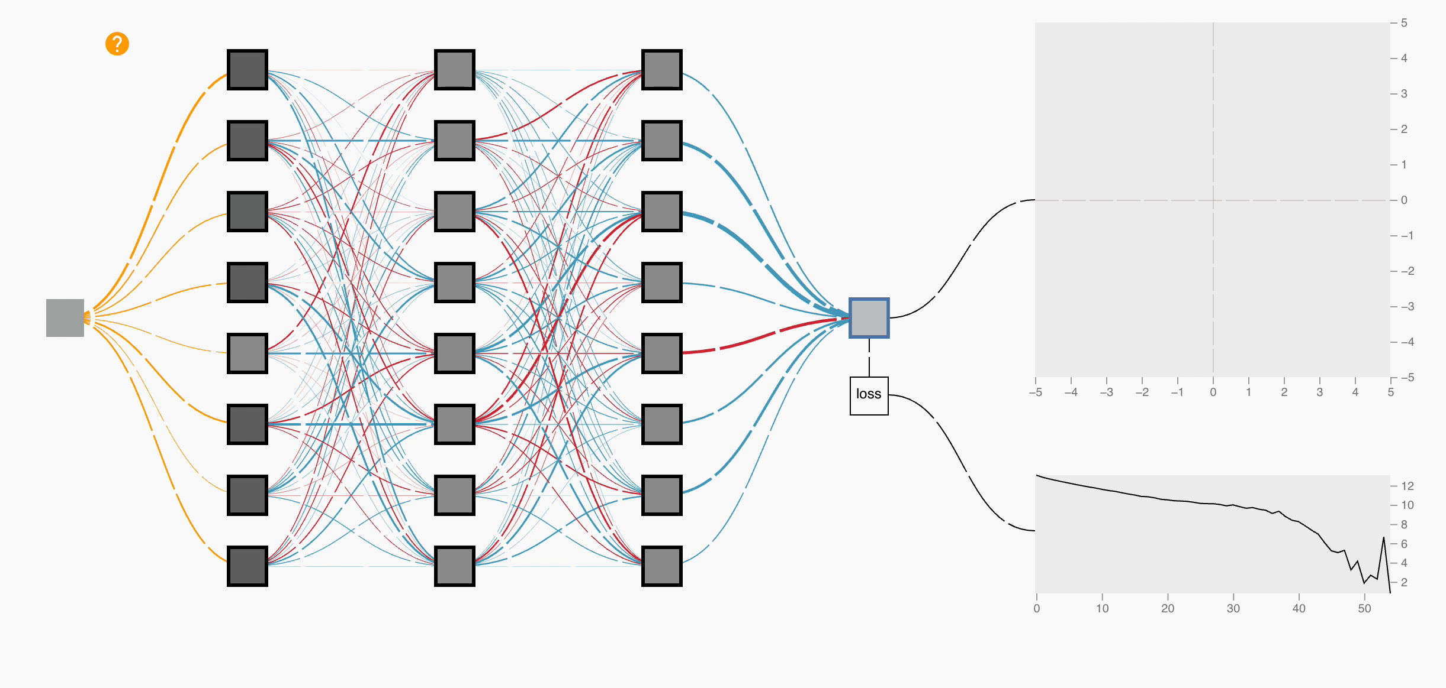
Learning from Mistakes
When a neural network is initiated, its parameters are random.
The initial outputs will be very bad → High loss value.
We can course correct based on the loss value (more accurately its gradient), adjusting our neural network parameters backwards!
Flow of error signal starts at the output.

Slide 5
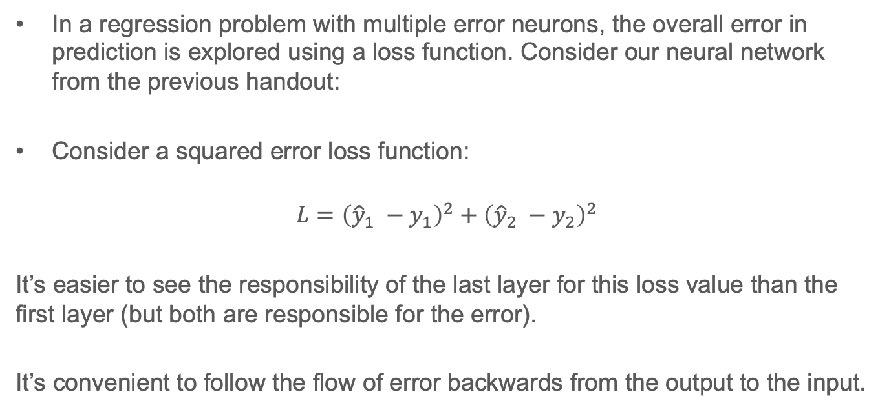
Error Propagation
In a regression problem with multiple error neurons, the overall error in prediction is explored using a loss function. Consider our neural network from the previous handout:
Consider a squared error loss function:
$$L={\left({\hat{y}}_{1} −y_{1}\right)}^{2}+{\left({\hat{y}}_{2} −y_{2}\right)}^{2}$$
It’s easier to see the responsibility of the last layer for this loss value than the first layer (but both are responsible for the error).
It’s convenient to follow the flow of error backwards from the output to the input.

Slide 6



Error Propagation

Slide 7








Gradient Descent

Slide 8








Gradient Descent

Slide 9












Extra notes

Slide 10









Extra notes

Slide 11
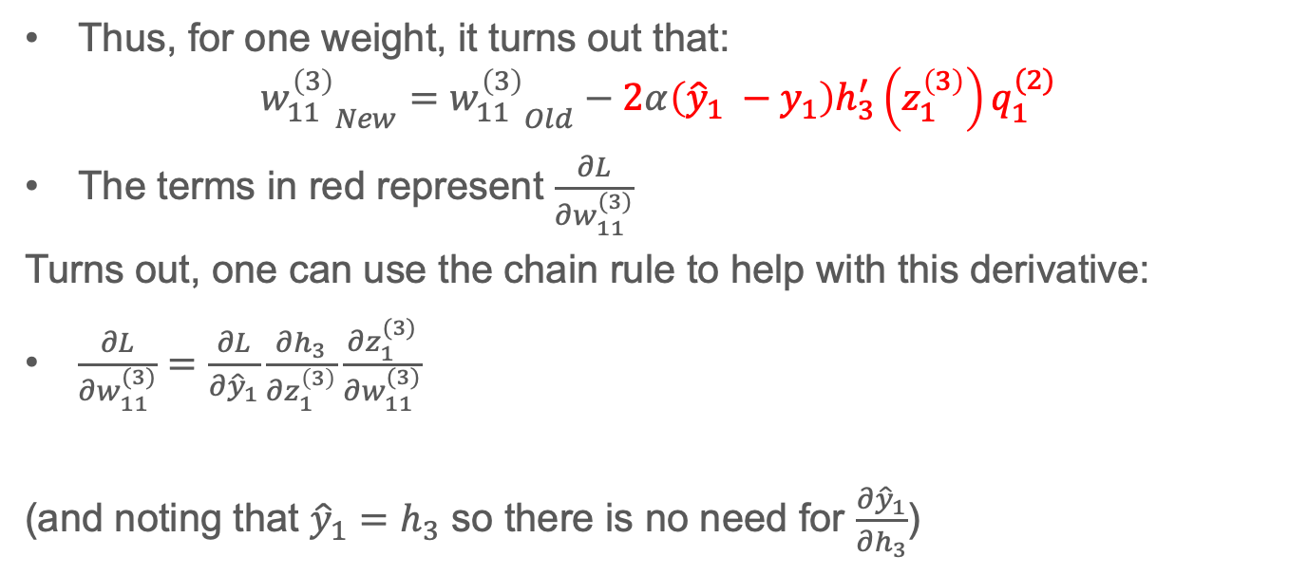
Updating one weight
Thus, for one weight, it turns out that:
$${w_{11}^{\left(3\right)}}_{New}={w_{11}^{\left(3\right)}}_{Old}−2α\left({\hat{y}}_{1} −y_{1}\right)h_{3}^{′}\left(z_{1}^{\left(3\right)}\right)q_{1}^{(2)}$$
The terms in red represent $\frac{∂L}{∂w_{11}^{(3)}}$
Turns out, one can use the chain rule to help with this derivative:
$\frac{∂L}{∂w_{11}^{(3)}}=\frac{∂L}{∂{\hat{y}}_{1}}\frac{∂h_{3}}{∂z_{1}^{\left(3\right)}}\frac{∂z_{1}^{(3)}}{∂w_{11}^{(3)}}$
(and noting that ${\hat{y}}_{1}=h_{3}$ so there is no need for $\frac{∂{\hat{y}}_{1}}{∂h_{3}}$)

Slide 12
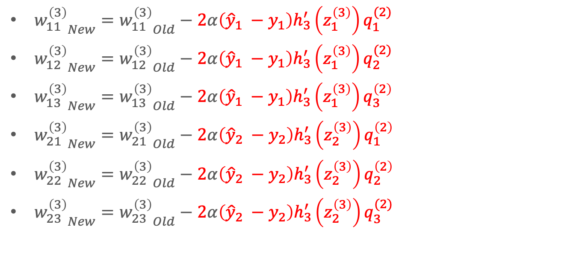
Updating other weights in the output layer
${w_{11}^{\left(3\right)}}_{New}={w_{11}^{\left(3\right)}}_{Old}−2α\left({\hat{y}}_{1} −y_{1}\right)h_{3}^{′}\left(z_{1}^{\left(3\right)}\right)q_{1}^{(2)}$
${w_{12}^{\left(3\right)}}_{New}={w_{12}^{\left(3\right)}}_{Old}−2α\left({\hat{y}}_{1} −y_{1}\right)h_{3}^{′}\left(z_{1}^{\left(3\right)}\right)q_{2}^{(2)}$
${w_{13}^{\left(3\right)}}_{New}={w_{13}^{\left(3\right)}}_{Old}−2α\left({\hat{y}}_{1} −y_{1}\right)h_{3}^{′}\left(z_{1}^{\left(3\right)}\right)q_{3}^{\left(2\right)}$
${w_{21}^{\left(3\right)}}_{New}={w_{21}^{\left(3\right)}}_{Old}−2α\left({\hat{y}}_{2} −y_{2}\right)h_{3}^{′}\left(z_{2}^{\left(3\right)}\right)q_{1}^{\left(2\right)}$
${w_{22}^{\left(3\right)}}_{New}={w_{22}^{\left(3\right)}}_{Old}−2α\left({\hat{y}}_{2} −y_{2}\right)h_{3}^{′}\left(z_{2}^{\left(3\right)}\right)q_{2}^{\left(2\right)}$
${w_{23}^{\left(3\right)}}_{New}={w_{23}^{\left(3\right)}}_{Old}−2α\left({\hat{y}}_{2} −y_{2}\right)h_{3}^{′}\left(z_{2}^{\left(3\right)}\right)q_{3}^{(2)}$

Slide 13
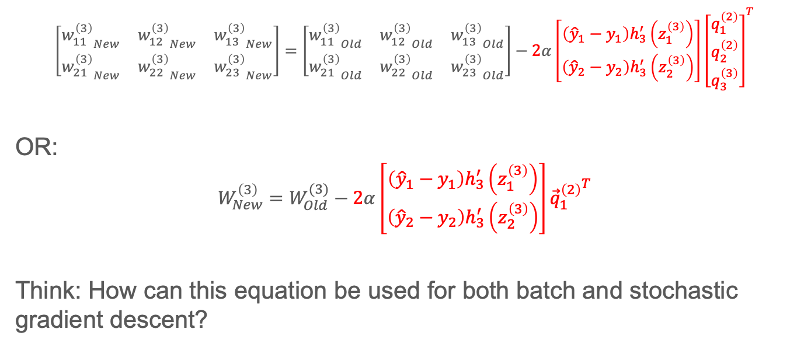
Matrix Form Equation (Updating weights in last layer)
$$\left[\begin{matrix}{w_{11}^{\left(3\right)}}_{New} & {w_{12}^{\left(3\right)}}_{New} & {w_{13}^{\left(3\right)}}_{New} \\ {w_{21}^{\left(3\right)}}_{New} & {w_{22}^{\left(3\right)}}_{New} & {w_{23}^{\left(3\right)}}_{New}\end{matrix}\right]=\left[\begin{matrix}{w_{11}^{\left(3\right)}}_{Old} & {w_{12}^{\left(3\right)}}_{Old} & {w_{13}^{\left(3\right)}}_{Old} \\ {w_{21}^{\left(3\right)}}_{Old} & {w_{22}^{\left(3\right)}}_{Old} & {w_{23}^{\left(3\right)}}_{Old}\end{matrix}\right]−2α\left[\begin{matrix}\left({\hat{y}}_{1}−y_{1}\right)h_{3}^{′}\left(z_{1}^{\left(3\right)}\right) \\ \left({\hat{y}}_{2}−y_{2}\right)h_{3}^{′}\left(z_{2}^{\left(3\right)}\right)\end{matrix}\right]{\left[\begin{matrix}q_{1}^{\left(2\right)} \\ q_{2}^{\left(2\right)} \\ q_{3}^{\left(3\right)}\end{matrix}\right]}^{T}$$
OR:
$$W_{New}^{\left(3\right)}=W_{Old}^{(3)}−2α\left[\begin{matrix}\left({\hat{y}}_{1}−y_{1}\right)h_{3}^{′}\left(z_{1}^{\left(3\right)}\right) \\ \left({\hat{y}}_{2}−y_{2}\right)h_{3}^{′}\left(z_{2}^{\left(3\right)}\right)\end{matrix}\right]{{\vec{q}}_{1}^{\left(2\right)}}^{T}$$
Think: How can this equation be used for both batch and stochastic gradient descent?
Notes:
The terms in red in the equation represent the gradient of the loss value with respect to the weights in layer 3
Stochastic gradient descent: Gradient is evaluated for one input datapoint.
Mini-batch Stochastic gradient descent: Gradient is evaluated for a mini-batch of input data. The gradient is averaged before being used in the update equation.
Batch Stochastic gradient descent: Gradient is evaluated for a all training input data. The gradient is averaged before being used in the update equation.

Slide 14

Matrix Form Equation (Updating biases in last layer)
$$\left[\begin{aligned}{b_{1}^{\left(3\right)}}_{new} \\ {b_{2}^{\left(3\right)}}_{new}\end{aligned}\right]=\left[\begin{aligned}{b_{1}^{\left(3\right)}}_{old} \\ {b_{2}^{\left(3\right)}}_{old}\end{aligned}\right]−2α\left[\begin{matrix}\left({\hat{y}}_{1}−y_{1}\right)h_{3}^{′}\left(z_{1}^{\left(3\right)}\right) \\ \left({\hat{y}}_{2}−y_{2}\right)h_{3}^{′}\left(z_{2}^{\left(3\right)}\right)\end{matrix}\right]$$
Or
$${\vec{b}}_{New}^{\left(3\right)}={\vec{b}}_{Old}^{\left(3\right)}−2α\left[\begin{matrix}\left({\hat{y}}_{1}−y_{1}\right)h_{3}^{′}\left(z_{1}^{\left(3\right)}\right) \\ \left({\hat{y}}_{2}−y_{2}\right)h_{3}^{′}\left(z_{2}^{\left(3\right)}\right)\end{matrix}\right]$$

Slide 15







Propagating the Error Further Back
Supposing the weight $w_{11}^{(2)}$ is changed. Look at what it affects:
Layer 2
Layer 1
Layer 3
$$w_{11}^{(2)}$$
Changing $w_{11}^{(2)}$ changes the outputs both ${\hat{y}}_{1}$ and ${\hat{y}}_{2}$
$$x_{1}$$
$${\hat{y}}_{1}$$
$$x_{2}$$
$${\hat{y}}_{2}$$

Slide 16







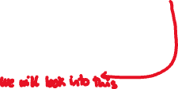

Propagating the Error Further Back
Therefore, looking at how $w_{11}^{(2)}$ changes the loss: $\frac{∂L}{∂w_{11}^{(2)}}$ :

Slide 17








Propagating the Error Further Back

Slide 18
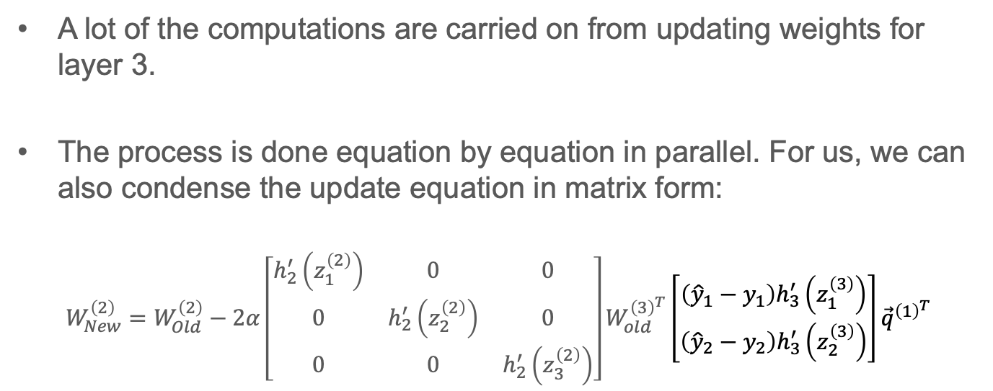
Updating all weights in Layer 2
A lot of the computations are carried on from updating weights for layer 3.
The process is done equation by equation in parallel. For us, we can also condense the update equation in matrix form:
$$W_{New}^{\left(2\right)}=W_{Old}^{\left(2\right)}−2α\left[\begin{matrix}h_{2}^{′}\left(z_{1}^{\left(2\right)}\right) & 0 & 0 \\ 0 & h_{2}^{′}\left(z_{2}^{\left(2\right)}\right) & 0 \\ 0 & 0 & h_{2}^{′}\left(z_{3}^{\left(2\right)}\right)\end{matrix}\right]W_{old}^{{\left(3\right)}^{T}}\left[\begin{matrix}\left({\hat{y}}_{1}−y_{1}\right)h_{3}^{′}\left(z_{1}^{\left(3\right)}\right) \\ \left({\hat{y}}_{2}−y_{2}\right)h_{3}^{′}\left(z_{2}^{\left(3\right)}\right)\end{matrix}\right]{\vec{q}}^{{\left(1\right)}^{T}}$$
*Updates for weights of layer 1 are left for you to try.

Slide 19
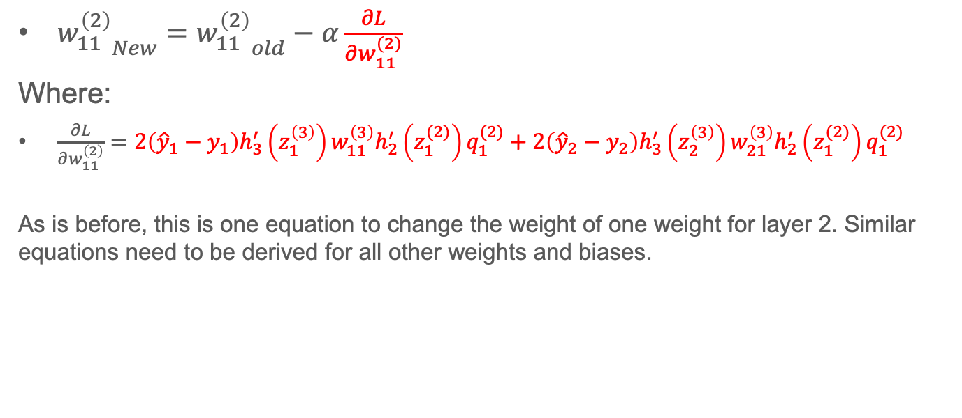
Problems with Gradient Descent
${w_{11}^{\left(2\right)}}_{New}={w_{11}^{\left(2\right)}}_{old}−α\frac{∂L}{∂w_{11}^{(2)}}$
Where:
$\frac{∂L}{∂w_{11}^{\left(2\right)}}=2\left({\hat{y}}_{1}−y_{1}\right)h_{3}^{′}\left(z_{1}^{\left(3\right)}\right)w_{11}^{\left(3\right)}h_{2}^{′}\left(z_{1}^{(2)}\right)q_{1}^{(2)}+2\left({\hat{y}}_{2}−y_{2}\right)h_{3}^{′}\left(z_{2}^{\left(3\right)}\right)w_{21}^{\left(3\right)}h_{2}^{′}\left(z_{1}^{(2)}\right)q_{1}^{(2)}$
As is before, this is one equation to change the weight of one weight for layer 2. Similar equations need to be derived for all other weights and biases.
Notice that, as we go further back in the network, the change in weight is proportional to multiples of derivatives of the neuronal activation function. The further you are from the output layer, the more multiples you get.

Slide 20
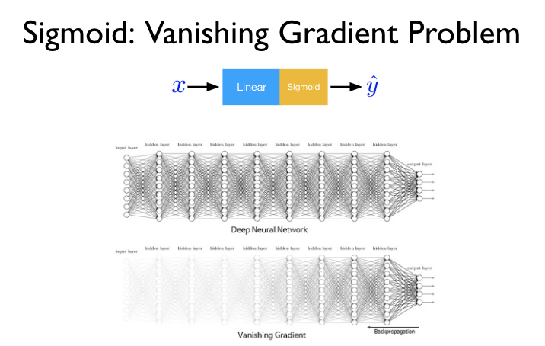
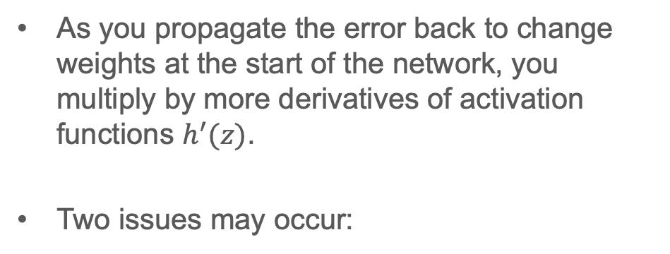
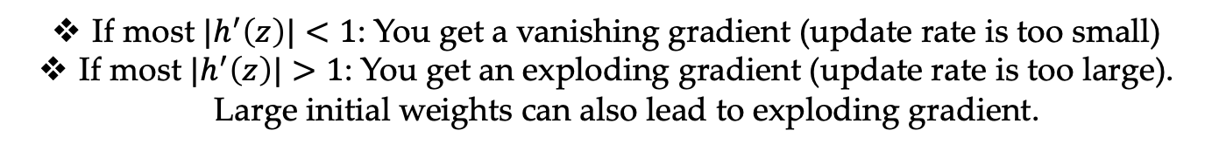
The Vanishing Gradient Problem
As you propagate the error back to change weights at the start of the network, you multiply by more derivatives of activation functions $h^{′}(z)$.
Two issues may occur:
If most ${|h}^{′}\left(z\right)|<1$: You get a vanishing gradient (update rate is too small)
If most ${|h}^{′}\left(z\right)|>1$: You get an exploding gradient (update rate is too large). Large initial weights can also lead to exploding gradient.

Slide 21
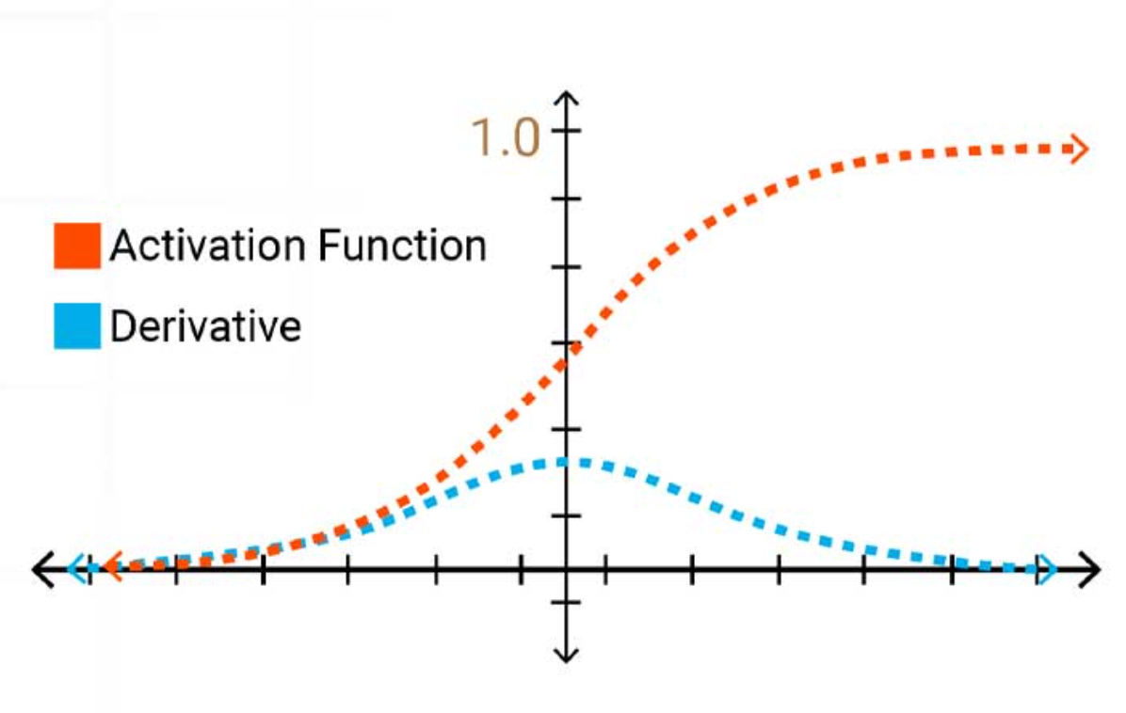
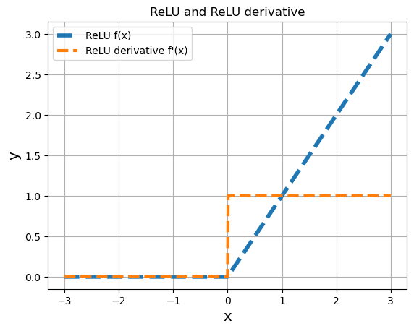
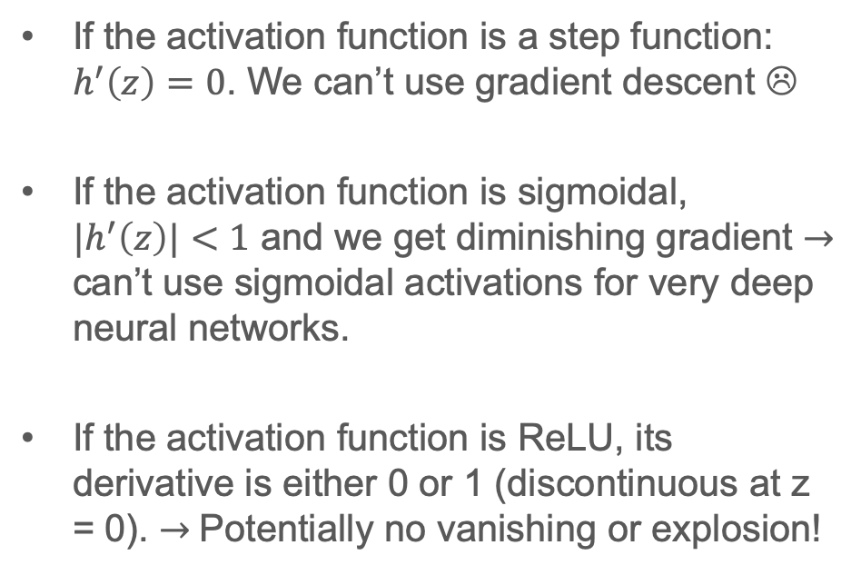
The Vanishing Gradient Problem
If the activation function is a step function: $h^{′}\left(z\right)=0$. We can’t use gradient descent ☹
If the activation function is sigmoidal, $|h^{′}\left(z\right)|<1$ and we get diminishing gradient $→$ can’t use sigmoidal activations for very deep neural networks.
If the activation function is ReLU, its derivative is either 0 or 1 (discontinuous at z = 0). $→$Potentially no vanishing or explosion!

Slide 22
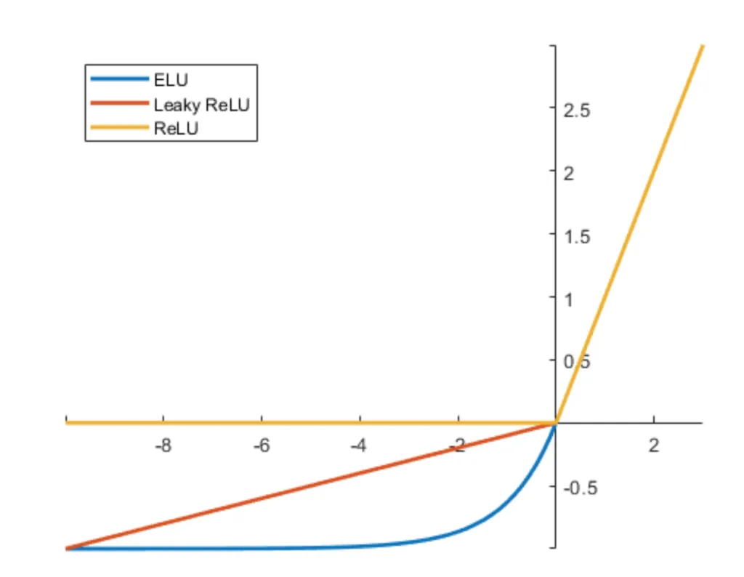
The Dying ReLU Problem
If the inputs to a neuron with ReLU activation are negative, the ReLU neuron turns off and its gradient never updates …
Solutions:
Initialize all neurons such that their output starts positive (start with some positive biases).
Choose weights to be relatively small initially (random selection from a normal distribution with small mean and small standard deviation)
Try different ReLU functions like Leaky ReLU or ELU (Exponential Linear Unit)

Slide 23
Conclusions
Neural Networks perform predictions by moving information from inputs through hidden layers (sequentially) into the output layer. Feedforward.
Neural Networks learn using gradient descent by propagating error backward from output layer into the input layer.
Learning process depends on network architecture and activation functions.
Some activations functions may have issues:
  Sigmoidal activation: Vanishing gradient.
  ReLU: Dead ReLU neurons

Slide 24
References
Materials from this handout used Machine Learning, A First Course for Engineers and Scientists by Lindholm et. al (March 4th, 2026 version), section 6.2 as a reference. Access to this document is free at the publishers’ GitHub page.
The following was also used for materials: Artificial Intelligence: A Modern Approach, Russel and Norvig, 4th edition, section 21.1.
Data-Driven Science and Engineering: Machine Learning, Dynamical Systems and Control, Brunton & Kutz, second edition. Section 6.3-6.4.

Slide 25
Extra notes

